Slide 1
P2P Apps
Presented by
Kevin Larson
&
Will Dietz

Slide 2
P2P In General
Distributed systems where workloads are partitioned between peers
Peer: Equally privileged members of the system
In contrast to client-server models, peers both provide and consume resources.
Classic Examples:
Napster
Gnutella

Slide 3
P2P Apps
CoDNS
Distribute DNS load to other clients in order to greatly reduce latency of non-cached entries.
UsenetDHT
Use peers to distribute the storage and costs of the Usenet service
PAST
Distribute files and replicas across many peers, using diversion and hashing to increase utilization and insertion success

Slide 4
CoDNS
OSDI 2004
Princeton
KyoungSoo Park
Zhe Wang
Vivek Pai
Larry Peterson
Presented by Kevin Larson

Slide 5
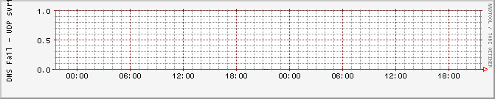
What is DNS?
Domain Name System
Translates traditional URLs into IP addresses
Ex: www.illinois.edu -> 128.174.4.87
Ubiquitous and long-standing: Average user not aware of its existence
Desired Performance, as observed PlanetLab nodes at Rice and University of Utah

Slide 6
Environment and Workload
PlanetLab
Internet scale test-bed
Very large scale
Geographically distributed
CoDeeN
Latency-sensitive content delivery network (CDN)
Uses a network of caching Web proxy servers
Complex distribution of node accesses + external accesses
Built on top of PlanetLab
Widely used (4 million plus accesses/day)

Slide 7
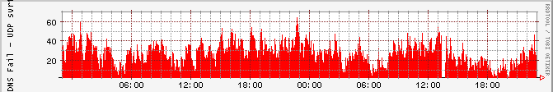
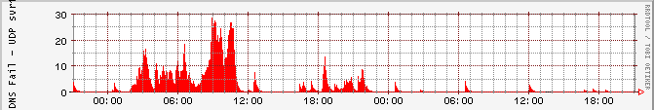
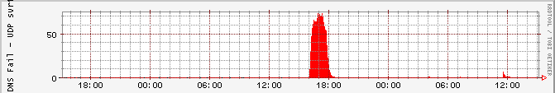
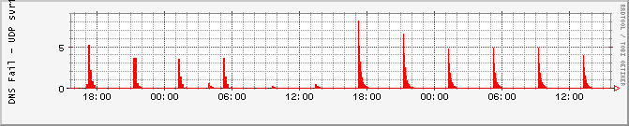
Observed Performance
Cornell
University of Oregon
University of Michigan
University of Tennessee

Slide 8
What is not working?
DNS lookups are high reliability, but failures are still responsible for significant delays.
Reliability due to redundancy, which drives up latency
Failures significantly skew average lookup times
Failures defined as:
5+ second latency – the length of time where the system will contact a secondary local nameserver
No answer
Is this a reasonable metric for failure?

Slide 9
Time Spent on DNS lookups
Three classifications of lookup times:
Low: <10ms
Regular: 10ms to 100ms
High: >100ms
71%-99.2% of time is spent on high latency lookups, despite accounting for 0.5% to 12.9% of accesses
Time spent on failure dominates overall lookup time

Slide 10
Failure Classification
Long lasting, continuous failures:
- Result from nameserver failures and extended overloading
Cornell
Short sporadic failures:
- Result from temporary overloading
University of Oregon
Periodic Failures – caused by cron jobs and other scheduled tasks
University of Michigan
University of Tennessee

Slide 11
CoDNS Ideas
Attempt to resolve locally, then request data from peers if too slow
Distribute DNS cache across many peers - Improve size and performance of “global cache”
Design questions:
How important is locality ?
How soon should you attempt to contact a peer?
How many peers to contact?

Slide 12
CoDNS Counter-thoughts
This seems unnecessarily complex – why not just go to another local or root nameserver?
Many failures are overload related, more aggressive contact of nameservers would just aggravate the problem
Is this worth the increased load on peer’s DNS servers and the bandwidth of duplicating requests?
Failure times were not consistent between peers, so this likely will have minimal negative effect

Slide 13
CoDNS Implementation
Stand-alone daemon on each node
UDP for queries, TCP for local name lookups
Master & slave processes for resolution
Master reissues requests if slaves are too slow
Doubles delay after first retry
Dynamic reissue delay

Slide 14
Results
Overall, average responses improved between between 16% and 75%
Host lookups: 37ms to 7ms
Real Traffic: 237ms to 84ms
At Cornell, the worst performing node, average response times massively reduced:
Host lookups: 554ms to 21ms
Real Traffic: 1095ms to 79ms

Slide 15
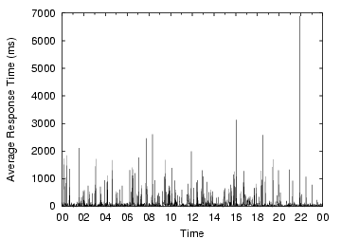
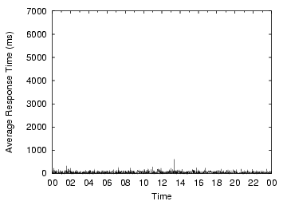
Results: One Day of Traffic
Local DNS
CoDNS

Slide 16
Observations
Three observed cases where CoDNS doesn’t provide benefit:
Name does not exist
Local nameserver poorly gathers neighbors
Network prevents CoDNS from contacting peers
CoDNS uses peers for 18.9% of lookups
34.6% of remote queries return faster than local lookup.

Slide 17
Overhead
Extra DNS lookups:
Controllable via variable initial delay time
Naive 500ms delay adds about 10% overhead
Dynamic delay adds only 18.9%
Extra Network Traffic:
Remote queries and heartbeats only account for about 520MB/day across all nodes
Only 0.3% overhead for CoDeeN workload

Slide 18
Questions
The authors took a black box approach towards observing and working with the DNS servers, do you think a more integrated method could further improve observations or results?
CoDNS proved to work remarkably well in the PlanetLab environment, would it behave comparably in a home environment?
If not, where else could the architecture prove useful?

Slide 19
Questions (continued)
It seems a surprising number of failures result from Cron jobs, should this have been a task for policy or policy enforcement?
Are there any other tasks where failures dominate usage, and could benefit from knowledge gained by CoDNS?

Slide 20
PAST
“Storage management and caching in PAST, a large-scale persistent peer-to-peer storage utility”
SOSP 2001
Antony Rowstron (antr@microsoft.com)
Peter DRUSCHEL (DRUSCHEL@cs.rice.edu)
Presented by Will Dietz

Slide 21
PAST Introduction
Distributed Peer-to-Peer Storage System
Meant for archival backup, not as filesystem
Files stored together, not split apart
Built on top of Pastry
Routing layer, locality benefits
Basic concept as DHT object store
Hash file to get fileID
Use pastry to send file to node with nodeID closest to fileID
API as expected
Insert, Lookup, Reclaim

Slide 22
Pastry Review
Self-organizing overlay network
Each node hashed to nodeID, circular nodeID space.
Prefix routing
O(log(n)) routing table size
O(log(n)) message forwarding steps
Network Proximity Routing
Routing entries biased towards closer nodes
With respect to some scalar distance metric (# hops, etc)

Slide 23
Pastry Review, continued
d467c4
d471f1
d467c4
d462ba
d46a1c
d4213f
Proximity space
Route(d46a1c)
d13da3
65a1fc
d4213f
New node: d46a1c
65a1fc
NodeId space
d462ba
d13da3

Slide 24
PAST – Insert
fileID = insert(name, …, k, file)
‘k’ is requested duplication
Hash (file, name, and random salt) to get fileID
Route file to node with nodeID closest to fileID
Pastry, O(log(N)) steps
Node and it’s k closest neighbors store replicas
More on what happens if they can’t store the file later

Slide 25
PAST – Lookup
file = lookup(fileID);
Route to node closest to fileID.
Will find closest of the k replicated copies
(With high probability)
Pastry’s locality properties

Slide 26
PAST – Reclaim
reclaim(fileId, …)
Send messages to node closest to file
Node and the replicas can now delete file as they see fit
Does not guarantee deletion
Simply no longer guarantees it won’t be deleted
Avoids complexity of deletion agreement protocols

Slide 27
Is this good enough?
Basic DHT experiment found:
Many insertion failures (51.1%)
Poor system utilization (60.8%)
Compared with (full) PAST:
Low insertion failures: (0-11.98%)
High system utilization (97.4%-99.7%)
Numbers from NATLR web proxy trace
Full details in evaluation later
Hosts modeled after corporate desktop environment
What causes all the failures?

Slide 28
The Problem
Storage Imbalance
Why?
File assignment might be uneven
Despite hashing properties
Files are different sizes
Nodes have different capacities
Note: Pastry assumes order of 2 magnitude capacity difference
Too small, node rejected
Too large, node requested to rejoin as multiple nodes
Would imbalance be as much of a problem if the files were fragmented?

Slide 29
The Solution: Storage Management
Replica Diversion
Concept: Balance free space amongst nodes in a leaf set
File Diversion
Concept: If replica diversion fails, try elsewhere
Replication maintenance
How does PAST ensure sufficient replicas exist?

Slide 30
Replica Diversion
Concept
Balance free space amongst nodes in a leaf set
Consider insert request:
k=4
fileId
Insert fileId

Slide 31
Replica Diversion
What if node ‘A’ can’t store the file?
Tries to find some node ‘B’ to store the files instead
…
C
A
N
B
…
k=4

Slide 32
Replica Diversion
How to pick node ‘B’?
Find the node with the most free space that:
Is in the leaf set of ‘A’
Is not be one of the original k-closest
Does not already have the file
Store pointer to ‘B’ in ‘A’ (if ‘B’ can store the file)

Slide 33
Replica Diversion
What if ‘A’ fails?
Pointer doubles chance of losing copy stored at ‘B’
Store pointer in ‘C’ as well! (‘C’ being k+1 closest)
…
C
A
N
B
…
k=4

Slide 34
Replica Diversion
When to divert?
(file size) / (free space) > t ?
‘t’ is system parameter
What if ‘B’ can’t store it either?
Size / space > t_pri ?
Size / space > t_div ?
…
C
A
N
B
…
k=4
t_pri > t_div, prioritize primary replicas at a node over storing diverted files

Slide 35
File Diversion
What if ‘B’ cannot store the file either?
Due to threshold
Concept:
That portion of the ring is overloaded
Try elsewhere!
Recall: fileID is result of hash
…Including random salt
Solution: Create new salt, therefore new hash
Try again, up to three times
If still fails, system cannot accommodate the file
Application may choose to fragment file and try again

Slide 36
Replica Management
Node failure (permanent or transient)
Pastry notices failure with keep-alive messages
Leaf sets updated
Copy file to node that’s now k-closest
…
C
A
N
…
k=4
…and

Slide 37
Replica Management
When node fails, some node ‘D’ is now k-closest
What if ‘D’ node cannot store the file? (threshold)
Try Replica Diversion from ‘D’!
What if ‘D’ cannot find a node to store replica?
Try Replica Diversion from farthest node in ‘D’s leaf set
What if that fails?
Give up, allow there to be < k replicas
Claim: If this happens, system must be too overloaded
Discussion: Thoughts?
Is giving up reasonable?
Should file owner be notified somehow?

Slide 38
Caching
Concept:
As requests are routed, cache files locally
Popular files cached
Make use of unused space
Cache locality
Due to Pastry’s proximity
Cache Policy: GreeyDual-Size (GD-S)
Weighted entries: (# cache hits) / (file size)
Discussion:
Is this a good cache policy?

Slide 39
Security
Public/private key encryption
Smartcards
Insert, reclaim requests signed
Lookup requests not protected
Clients can give PAST an encrypted file to fix this
Randomized routing (Pastry)
Storage quotas

Slide 40
Evaluation
Two workloads tested
Web proxy trace from NLANR
1.8million unique URLS
18.7 GB content, mean 10.5kB, median 1.3kB, [0B,138MB]
Filesystem (combination of filesystems authors had)
2.02million files
166.6GB, mean 88.2kB, median 4.5kB, [0,2.7GB]
2250 Past nodes, k=5
Node capacities modeled after corporate network desktops
Truncated normal distribution, mean +- 1 standard deviation

Slide 41
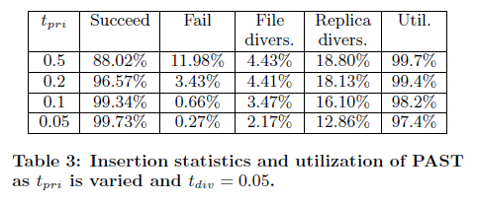
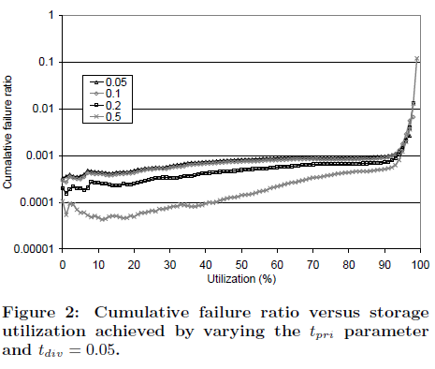
Evaluation (1)
As t_pri increases:
More utilization
More failures
Why?

Slide 42
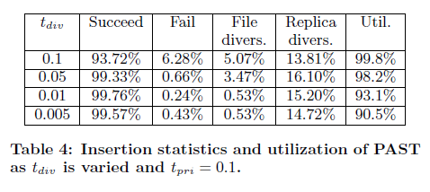
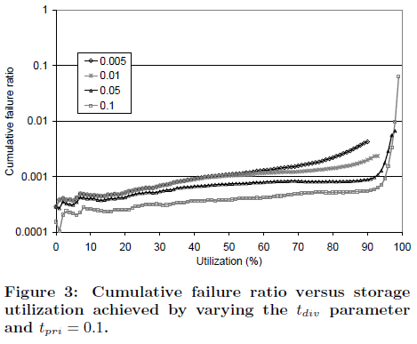
Evaluation (2)
As t_div increases:
More failures
More utilization
Why?

Slide 43
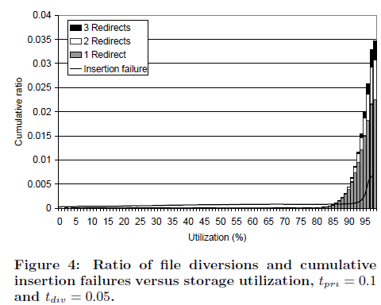
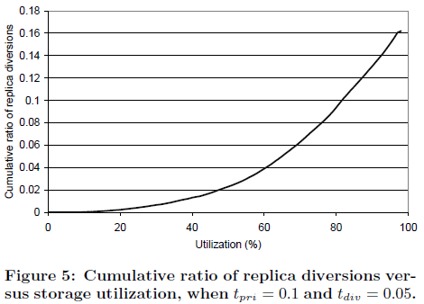
Evaluation (3)

Slide 44
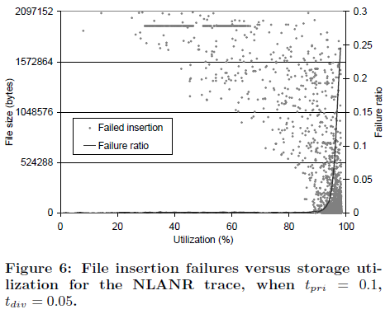
Evaluation (4)
As system utilization increases:
More failures
Smaller files fail more
What causes this?

Slide 45
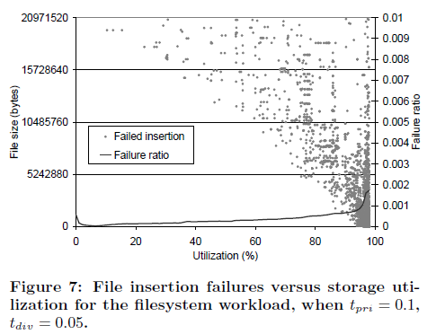
Evaluation (5)
As system utilization increases:
More failures
Smaller files fail more
What causes this?

Slide 46
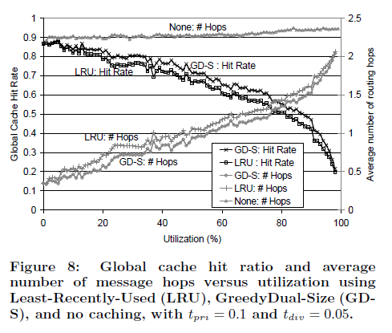
Evaluation (6)
Caching

Slide 47
Discussion
Block storage vs file storage?
Replace the threshold metric?
(file size)/(freespace) > t
Would you use PAST? What for?
Is P2P right solution for PAST?
For backup in general?
Economically sound?
Compared to tape drives, compared to cloud storage
Resilience to churn?

Slide 48
UsenetDHT
NDSI ’08
Emil sit
Robert Morris
M. Frans Kaashoek
MIT CSAIL

Slide 49
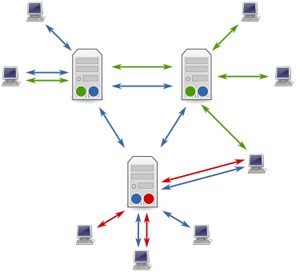
Background: Usenet
Distributed system for discussion
Threaded discussion
Headers, article body
Different (hierarchical) groups
Network of peering servers
Each server has full copy
Per-server retention policy
Articles shared via flood-fill
(Image from http://en.wikipedia.org/wiki/File:Usenet_servers_and_clients.svg)

Slide 50
UsenetDHT
Problem:
Each server stores copies of all articles (that it wants)
O(n) copies of each article!
Idea:
Store articles in common store
O(n) reduction of space used
UsenetDHT:
Peer-to-peer applications
Each node acts as Usenet frontend, and DHT node
Headers flood-filled as normal, articles stored in DHT

Slide 51
Discussion
What does this system gain from being P2P?
Why not separate storage from front-ends? (Articles in S3?)
Per-site filtering?
For those that read the paper…
Passing tone requires synchronized clocks– how to fix this?
Local caching
Trade-off between performance and required storage per node
How does this effect the bounds on number of messages?
Why isn’t this used today?

